Slide 1
Advanced Data Visualization with Python & Tableau
CSE Workshops
Speakers: Abhinav Tembulkar & Shubham Kumar Agrawal
Event Manager: Dhivya Ganeshan

Slide 2
Introduction
Why visualization matters ?

Slide 3
Same data, different stories
Behind every dataset lies a story — visualization is the language that reveals it.
Here are four Anscombe datasets with exactly same summaries. How different can actual datasets be ?
Dataset | Mean(x) | Mean(y) | Var(x) | Var(y) | Cor(x,y)
I | 9.00 | 7.50 | 11.00 | 4.13 | 0.82
II | 9.00 | 7.50 | 11.00 | 4.13 | 0.82
III | 9.00 | 7.50 | 11.00 | 4.13 | 0.82
IV | 9.00 | 7.50 | 11.00 | 4.13 | 0.82

Slide 4
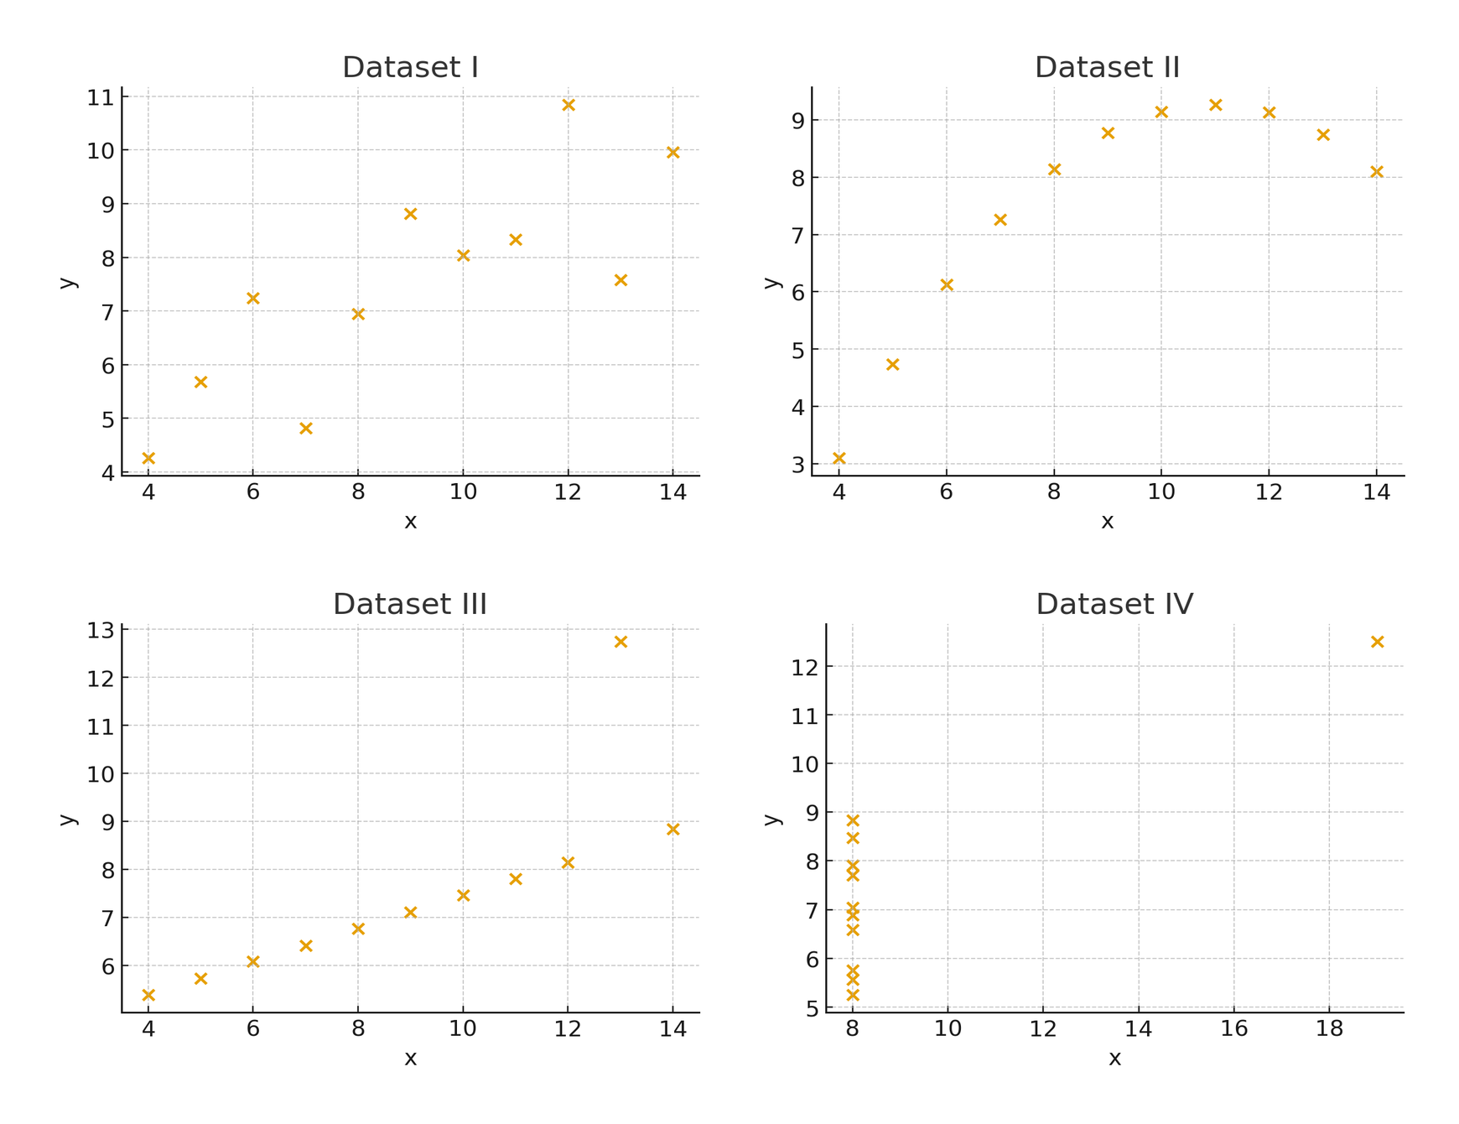
Same data, different stories
Visualization reveals structure.
Based on summaries, dataset should have similar structure.
However, datasets have radically different structure
Shapes, clusters and outliers only appear when we visualize data.

Slide 5
Same data, different stories
Aggregates can trick our understanding of data.
Anscombe lesson: same summaries ≠ same data — shape matters.
Let’s explore a different dataset ,
We’ll start with aggregates, facet data by one metric to see how stories completely changes.

Slide 6
UC Berkeley Dataset
How trends reverse upon visualization

Slide 7
UC Berkeley Dataset
In 1973, UC Berkeley recorded graduate admissions decisions across six departments with counts by gender.
At first glance, Aggregate numbers appear to show men being admitted more often than women.
UC Berkeley was sued for discrimination against women in graduate school admissions.
The data of percent acceptance indisputably show that, if a male applies to Berkeley, he is more likely to be admitted than a female that applies (44% vs. 35%).
But are the first impressions accurate ? Let’s find out

Slide 8
UC Berkeley Dataset
Scope & year: Graduate admissions decisions at UC Berkeley, 1973.
Contents:
Applicants: ~12,763 total
Variables:
Gender: Male / Female
Department: A–F (6 departments)
Admission Status : Admitted or Rejected

Slide 9

Link to Materials
In this notebook, we will investigate the dataset ourselves and find out who is wrong.
Link: http://bit.ly/4nTXA4U

Slide 10
Simpson’s Paradox

Slide 11
The Paradox
Simpson’s Paradox happens when a trend that appears in several groups of data reverses or disappears when the groups are combined.
At first glance, Aggregate numbers appear to show men being admitted more often than women.
Looking at totals → it looked like women were discriminated against.
Looking at departments → no bias (and sometimes a small advantage for women).
Takeaway:
Simpson's paradox is just a special case of ommitted variable bias.

Slide 12
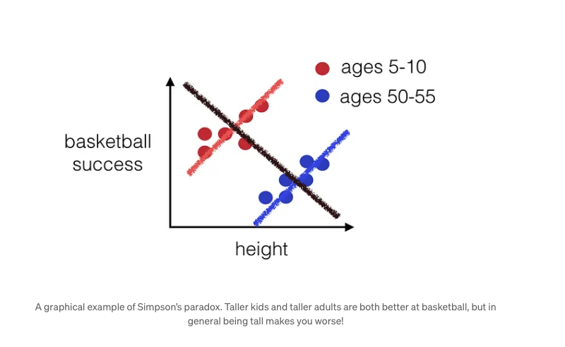

Slide 13
Advanced Visualizations using Tableau

Slide 14
Prerequisites
Familiarity with: - Basic charts (bar, line, pie) - Filters and sorting - Connecting to data sources Tools Required: - Tableau Desktop / Tableau Public

Slide 15
Why go beyond basic charts?
To create sophisticated visualizations that reveal deeper truths
To tell a cohesive data story.
To make your dashboards more interactive and modern.
To accommodate a wider range of data types.
To improve communication and engagement.

Slide 16
Why go beyond basic charts?
Level of Detail (LOD) Calculations
Table Calculations
Parameters for Dynamic Control
Dashboard Interactivity

Slide 17
Q&A

